Slide 1
Unit-6

Slide 2
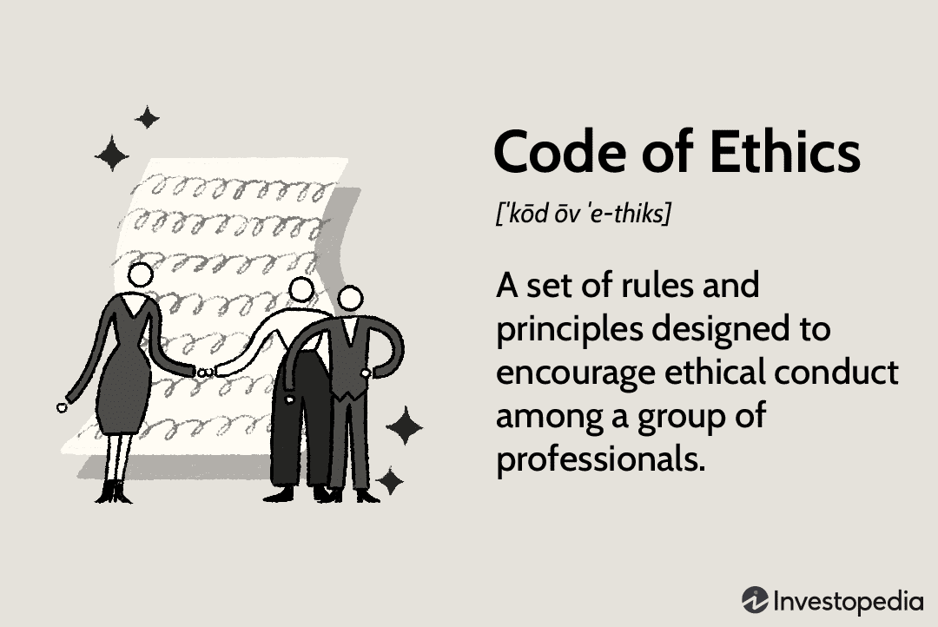
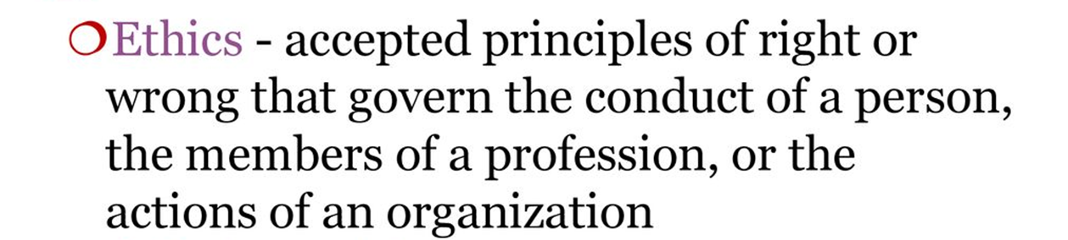

Slide 3
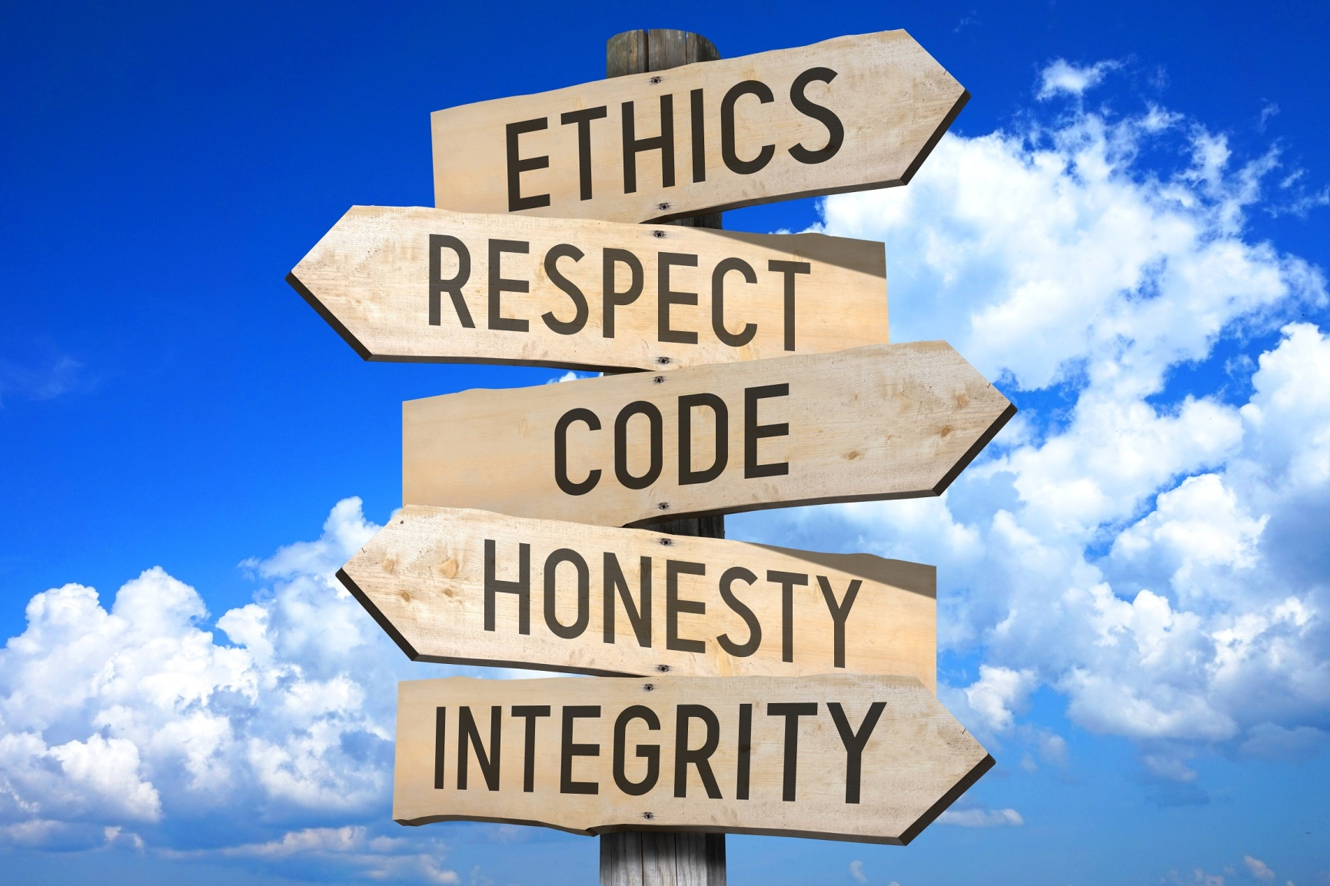

Slide 4
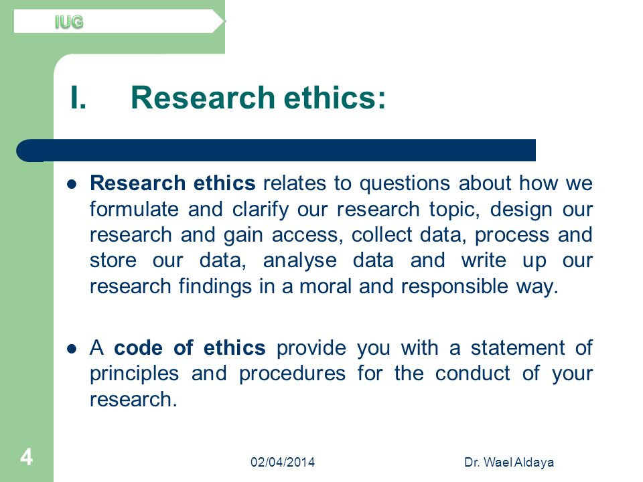

Slide 5
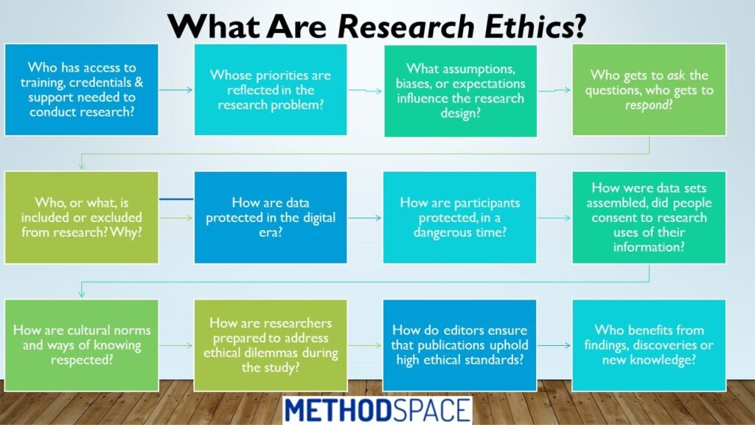

Slide 6
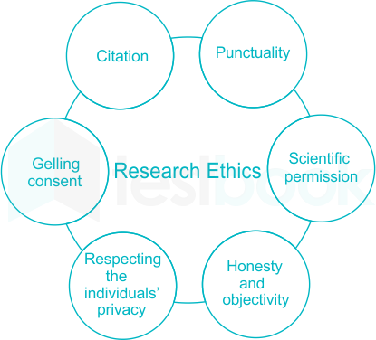

Slide 7
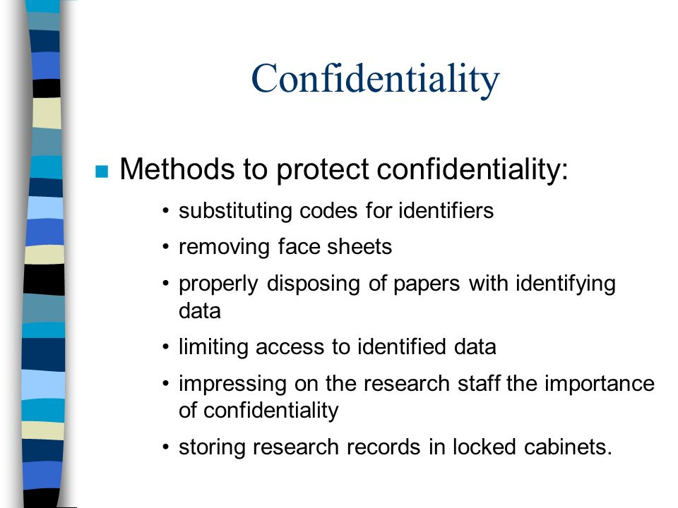

Slide 8
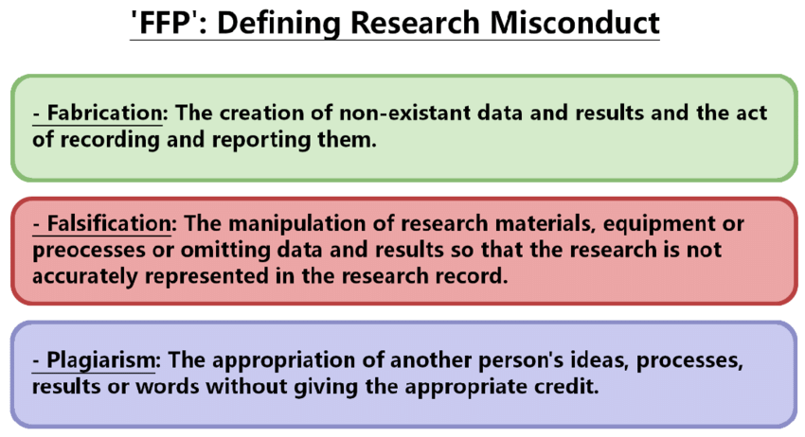

Slide 9
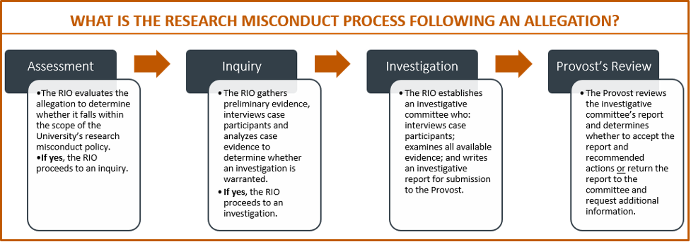
RIO-Research Integrity Officers

Slide 10
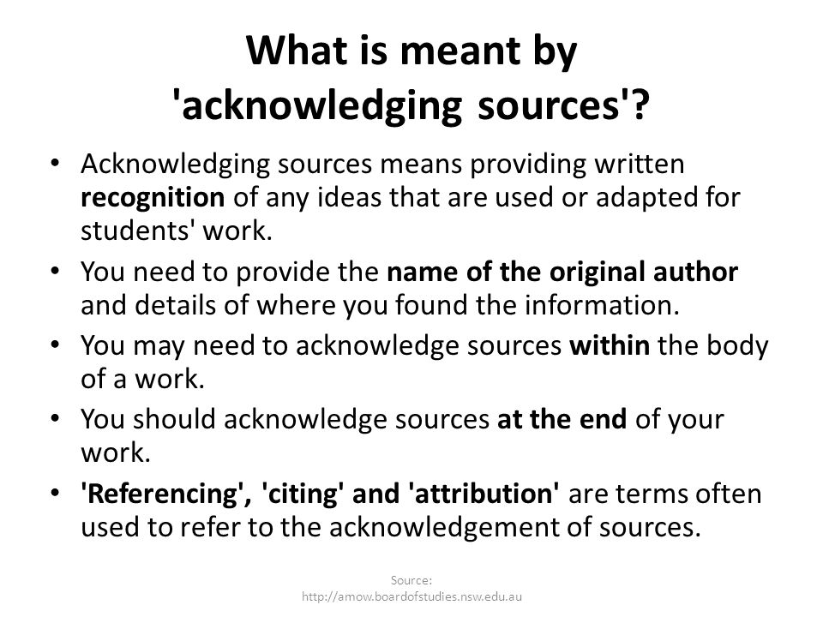

Slide 11
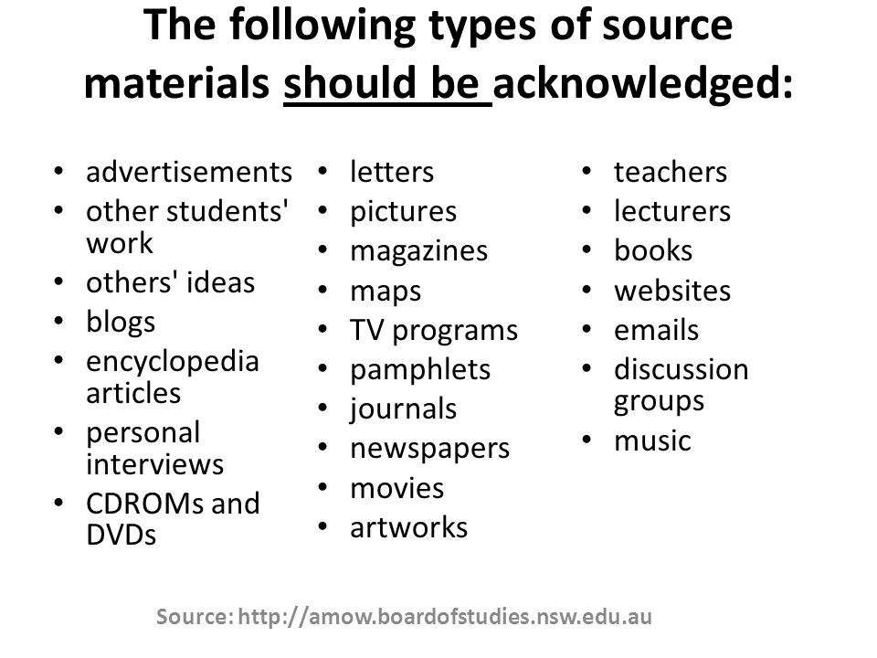

Slide 12
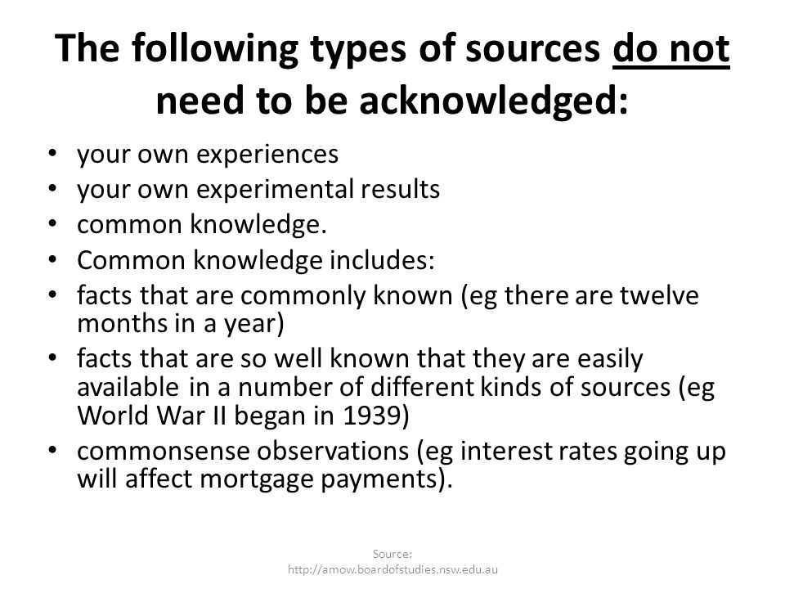

Slide 13
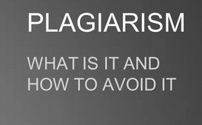

Slide 14
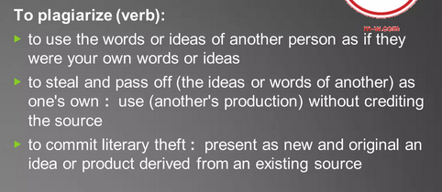

Slide 15
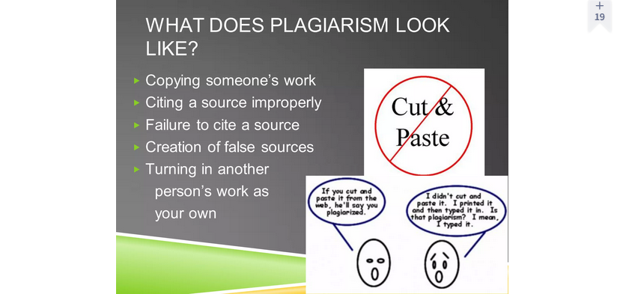

Slide 16
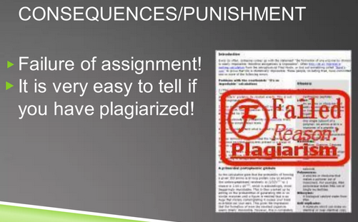

Slide 17
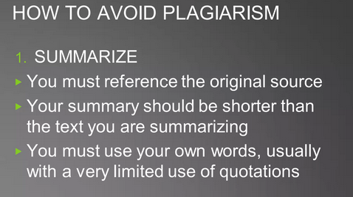

Slide 18
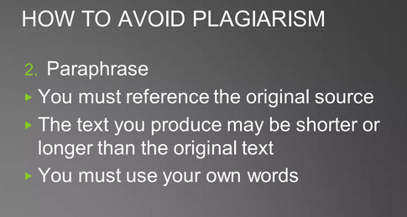

Slide 19
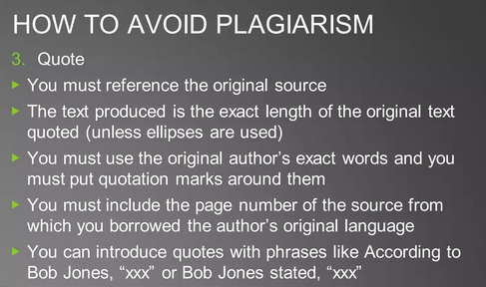

Slide 20

What is plagiarism checker software?
Plagiarism checker software is a tool that comes with algorithm-based text detection capabilities to recognize plagiarised content.
The tool scans web pages and databases (free as well as paid) to identify the usage of the same terms, quotes, sentences, paragraphs, and titles along with similarities in wording and paraphrasing.
Additionally, the software offers features such as writing suggestions, citation generator, and indexing.
Writers, bloggers, students, teachers, and professionals/businesses working on projects such as content creation, storytelling, and marketing make up the primary users of this type of software.
Plagiarism Checker in Grammarly

Slide 21
Common features of plagiarism checker software
Content scan | Scan written content in other documents, files, databases, or websites to check plagiarism.
Text similarity detection | Identify text similarities that are not identical but could be a result of paraphrasing or substituting, technically called mosaic(a picture or pattern that is made by placing together small coloured stones, pieces of glass, etc.)plagiarism.
Plagiarism report | Download and share results of plagiarism scan with stakeholders by highlighting parts of copied text in different colors.
Bulk upload | Upload multiple documents at once for cross-analysis.
Grammar checker | Check the text for proper grammar usage.
Side-by-side comparison | Compare two different documents and identify copied or paraphrased content.

Slide 22
What type of buyer are you?
Before purchasing a plagiarism checker tool, you should assess what kind of buyer you are. The majority of use cases fall into one of these categories:
Freelancers: If you’re freelancing, it is important to get recognized each time your work is referenced. Also, it is important to be alerted when you have unintentionally copied someone else’s work or missed a citation in your content. Plagiarism software enables you to stay on top of these tasks through comprehensive reporting, and thus, ensuring originality and honesty in your work.
Academic institutions: Plagiarism software enables educational institutions with in-depth analysis of students’ works. Some products allow evaluators to grade assignments as well. Paraphrasing and source citing suggestions greatly enhance the quality of students’ work, thus enhancing their productivity.
Business: If you are a business owner, ensuring the authenticity of your content should be one of the major reasons to adopt plagiarism checker software. Duplicate content not only impacts your reputation but SEO ranking as well. This becomes all the more important when you outsource your content creation

Slide 23
Benefits of plagiarism checker software
Here are the biggest benefits you will see from using online plagiarism checker software in your organization:
Multiple content and language support: The tool allows running plagiarism checks on multiple documents simultaneously. This avoids repeating the efforts on checking the originality of several iterations for a given (or similar) topic. A potential use case could be in academic institutions where teachers can check for plagiarized content in assignments submitted by the whole class. The content can also be checked for plagiarism in multiple languages.
Regulatory compliance and ethical limits: Plagiarism is not legal and if your content violates copyright laws, you can face copyright infringement charges with heavy penalties. The plagiarism checker software analyses the content and presents the analysis based on different metrics. You can see these results in the form of an extensive similarity report that highlights common words (which can be replaced with synonyms) as well as other suggestions that fit-in your work

Slide 24
Key considerations
With so many options and features to choose from, selecting the right plagiarism detection tool can quickly become overwhelming. To narrow the search list, here are some key factors to keep in mind when you evaluate different products:
Data protection: When searching for plagiarism detection software, check the product’s data sharing and retention policy. Your documents, which can be confidential, should not be made public or passed on to third parties without your permission. Also, deleted files should get completely erased from the software’s backend and not retained for any purpose. Prefer a solution that uses data and document encryption techniques to ensure safe upload/download/transfer.
Integration: Some plagiarism checker software offer product extensions that can be integrated with Microsoft Word, Apache Open Office, Google Docs, Google Chrome, etc. It enables users to check plagiarism and incorporate suggested edits easily while working on the document. Users can simply copy-paste the content into the extension’s workspace and identify plagiarized text.

Slide 25
Whitelisting: Some plagiarism detection tools allow users to define certain sources (such as specific websites or databases) that can be excluded from the checklist. For example, if you are a teacher and have asked your students to refer to certain online journals for an assignment, you can whitelist those sources so the software will not check for plagiarised content across those authorized sources. Similarly, if a business wants to exclude certain industry-specific terms/phrases during plagiarism scans, they can do so by whitelisting those terms.

Slide 26
Features of Plagiarism Detection Tool
Writers can get satisfaction and can be completely confident about their writings after checking them for plagiarism. Before you go for online checking, keep an eye on one thing that checker is certified.
1. Easier To Use
To check if there is any plagiarism in your work. Many free online tools that instantly examine your content. But many times its interface disturbs and you get confused.
Always prefer a tool due to its usability that brings instant results also you don’t need to wait for long hours to get a report of plagiarized issues. Basically it must have a place to insert text, and then a button like “check”, or “start”. As soon as you click the button, the checker starts scanning your text. After finishing the checking, it displays a list of results obtained. Also, some checkers provide you with an option of attaching your document file as well, for this you need to choose the option of “attach a file”.

Slide 27
2. Detailed Results
It must highlight the plagiarized content in yellow, red, or any other color. If a part of the sentence is copied, that will be highlighted and if there are fragments found in a sentence that is plagiarized, only those fragments will be highlighted.
Some checkers give results paragraph by paragraph. It makes you know how much of your paragraph needs to change. And if they provide you the sources along with content then consider it the perfect plagiarism detection tool.

Slide 28
3. Free of Charge
Many online plagiarism checkers do not ask you to spend a penny on checking your content. It’s all free. So, don’t use a paid tool for the daily scan. You can check thousands of documents and texts for 100% free.
4. Unlimited Conversions
There must be no limitation on conversion or usage, as you get the services of plagiarism. If it has a 24/7 service then select it and simply check your content uniqueness.
5. No Registration Required
If it does not ask you to get registered then it’s awesome. Because many sites provide long procedures to check your text for plagiarism and such sites mostly cost charges. But it always hectic to establish an account before using an online tool.

Slide 29
Plagiarism is always a very problematic issue throughout the educational career for all students. A little bit of plagiarism in assignments or reports can make students be fired for a long time that can ruin their future forever.
Guides to Avoid Content Duplication
If you are a student you will surely need to acquire help from the internet to make your assignments or reports plagiarism-free. That’s why students must focus on some guidelines to avoid any kind of duplication as follow:

Slide 30
Proofread Your Assignments
If you are a student at the university level, you may be worried about plagiarism of your reports and assignments. Because many times students make their assignment on their own but some of its sentences appear plagiarized in front of your professor, it will make you embarrassed and he may reject your assignment and may punish you to do all your work again.
Even though you don’t have copied any content from any other student or source, this situation will make you worried about how you can avoid it in the future. The simple answer to this question is a complete plagiarism check before submitting an assignment to your professors. And if it detects duplication you may paraphrase your text and create the latest version.

Slide 31
Source of Duplication
A free plagiarism checker for students is getting popular day by day. Teachers, students, and writers improve the quality of their content by checking their duplication. Because online tools show you the source name from where your sentences are copied intentionally or unintentionally, also they create a report for you.
So the best way is that you should cite your content and try to write your documents by using your own words to avoid plagiarism. Students are taking advantage of these sources so that they can make their assignments and reports free of duplication

Slide 32
Plagiarism can be any piece of writing or work of art that is copied without the consent of the owner. It especially concerns academic publications, journals, or other such works of an author. Also, images are copied without proper acknowledgment to the source but it’s easy to detect.
Common Types of Plagiarism
It is very simple to copy content from few sites because of open availability over the internet. And then combine them to form one piece of writing. That’s why plagiarize someone’s work is not a difficult task to do. Plagiarism is usually categorized into five common types as follow:
1. Direct Plagiarism
The first one is when other work or opinion is copied exactly without giving any sort of acknowledgment to that author. It’s a word-to-word copy of the content without using quotation marks and it’s totally unethical.
2. Paraphrasing Plagiarism
The second type is when the sequence of ideas, the material arrangement are copied without permission. It happens when you copy someone’s data or pattern and do some editions like rephrase words or changes in sentence structure. Many times students do a mistake, they change the title, and the rest of the content is the same. And imagine that they never find out that work has been copied. But there is strict constitutes plagiarism when content is going to live.

Slide 33
Self Plagiarism
Self-plagiarism is a term that means a person is trying to copying one’s old content and use it in the latest article or anything else. Auto plagiarism means that you rewrite your old content and submit it without the permission of all professors. It might be an article, a column, a paper, or research. Most of the authors feel that since it’s their own work, they can reuse it anyway and anywhere they want. Well, that’s not true.
4. Accidental Plagiarism
Another type of duplication is the accidental plagiarism, in which a person misquote a source with similar words or copy content unintentionally. However, it’s a mistake, negligence, or unintended paraphrasing but the consequences are the same as all plagiarism types.
5. Mosaic Plagiarism
Mosaic plagiarism also called patchwork plagiarism. It happens when someone copying content from many sites and regenerate material as their own. This practice may be intentional or unintentional but difficult to detect. But in every situation, you will be guilty of doing plagiarism.

Slide 34
How to Avoid Content Duplication?
Plagiarism in any form and type kills creativity. Scholars, professors are totally against this unethical behavior from students so, they always search for a perfect way to detect duplication. Also, plagiarism decrease website ranking because search engines such as Google and yahoo check out publish content for plagiarism. Thus, the huge database of these search engines is searched for finding out the relevant material. To avoid duplication you must understand some basic things as follow:
Use quotation mark
Create unique and original content
Credit to the original author
Check duplication before submission
Add references and citations

